Slide 1

Drop into berlin – A place recommender project
Leo Krohne | Lukas Bauerschmidt | 10th of March 2023

Slide 2
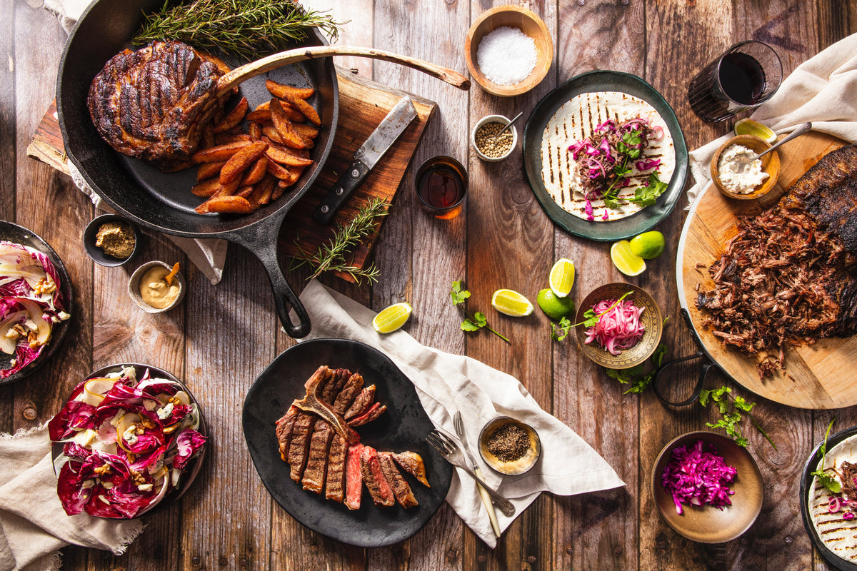
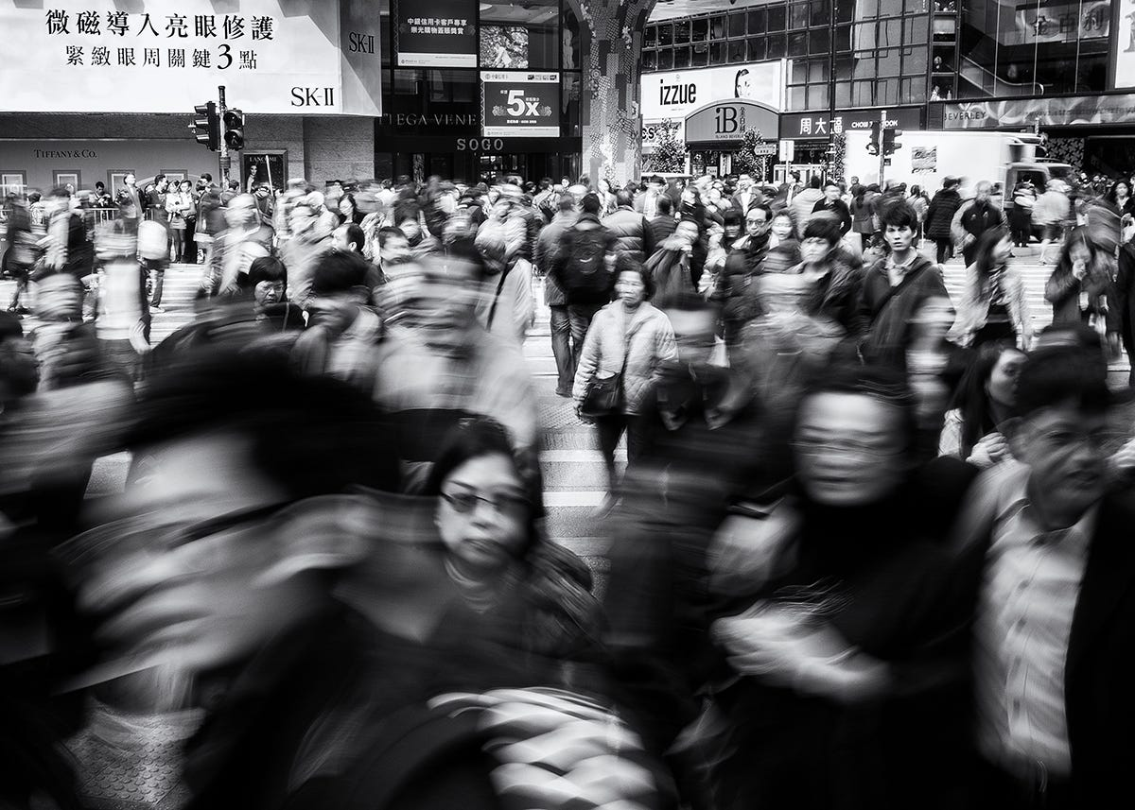
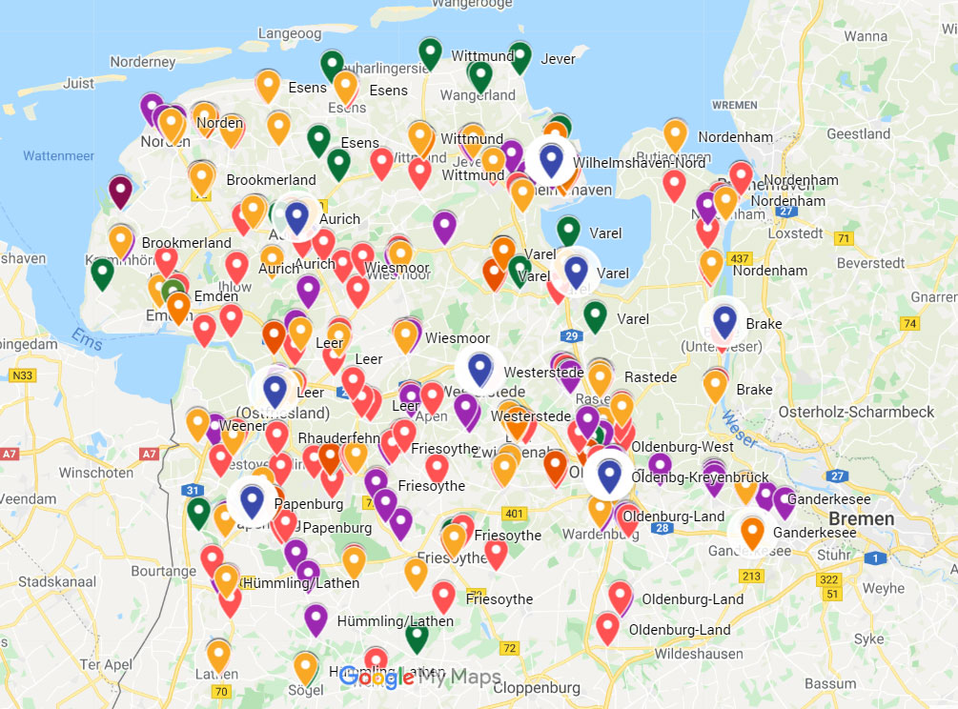
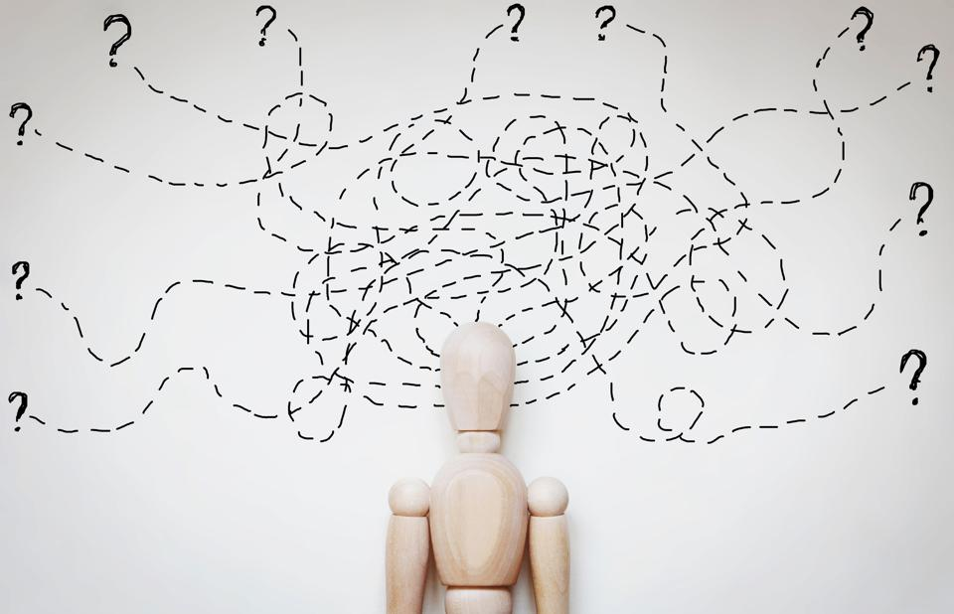
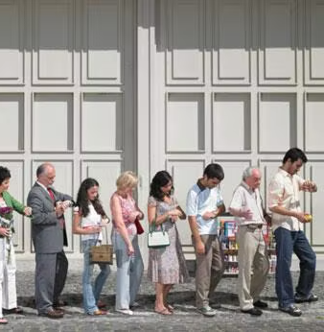
DROP INTO BERLIN
PROBLEMS
CONSTANT CITY HOPPING AND REGULAR DINING OUT
VARIETY OF RESTAURANTS, BARS & CLUBS IN BIG CITIES
Challenging to find comparable unique locations.
Requires time, money, and effort to evaluate each place individually.
LIMITED PERSONALIZED
SUGGESTIONS
LONG WAITING
TIMES
Browsing multiple platforms to find promising places
Especially in large cities, people need to queue up for restaurant access
Notes:
● At the beginning of our project phase, our team had an intense brainstorming session about nowadays second hand shopping
● We identified 4 major problems:
1.) First, there seems to be a fragmented supply, meaning there are several plattforms offering second hand clothes
2.) This implies that second hand shopping is time consuming, since users need to browse through multiple plattforms to find the right clothing items
3.) Thirdly, most of these second hand websites do not offer personalized suggestions
4.) And lastly, due to the current inflation, prices of new clothing items seems to rise significantly
● But before we started creating a product, matching these problems, we tried to better understand the market we aimed to penetrate as well as its consumer.

Slide 3
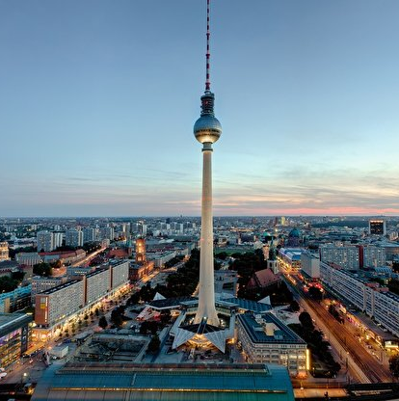


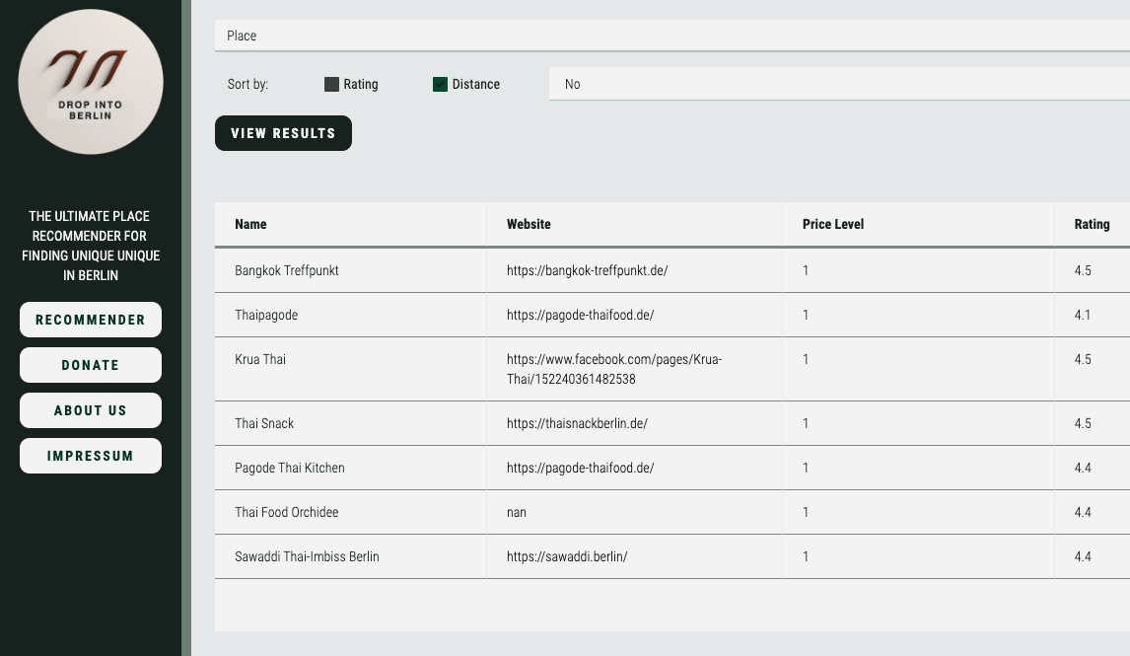



DROP INTO BERLIN
SOLUTION AND FEATURES
DROP INTO BERLIN
Outputs personalized AI based recommendation
Provides search function with filters
Considers real-time user reviews and ratings
Allows to discover "hidden" gems

Slide 4

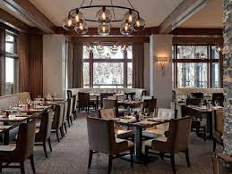
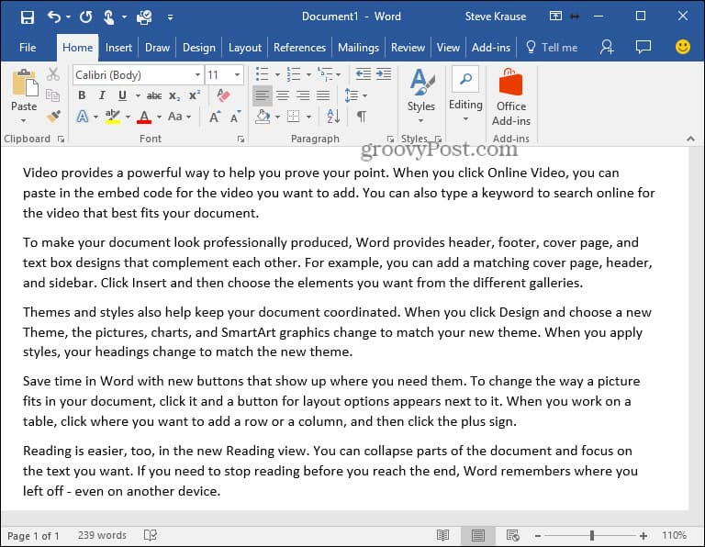

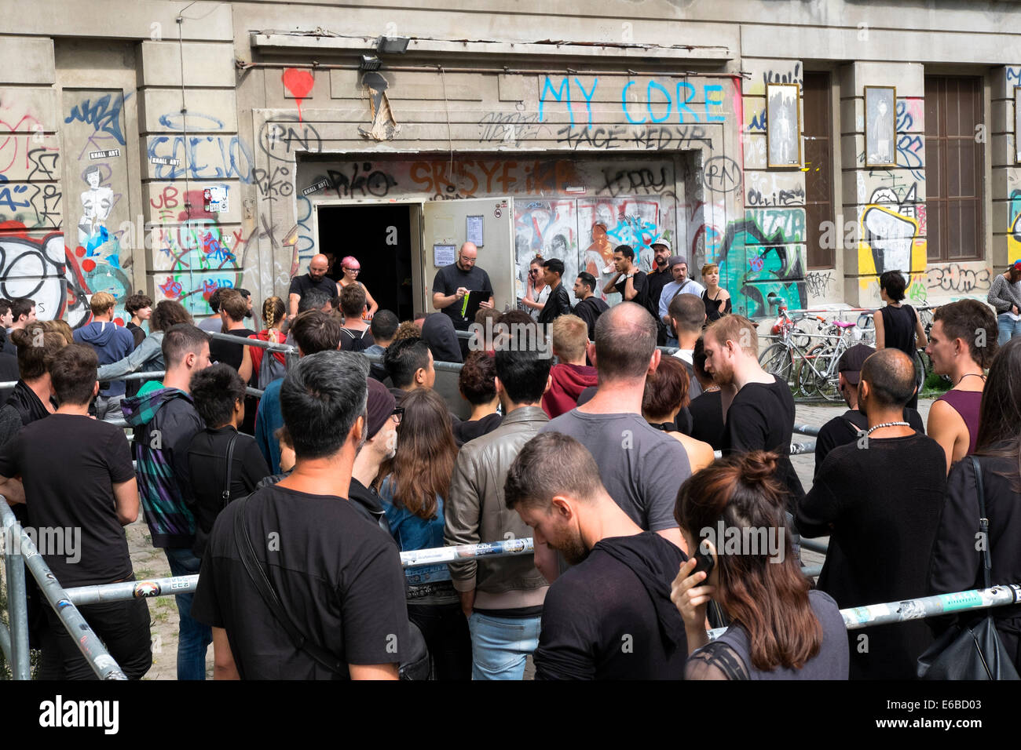

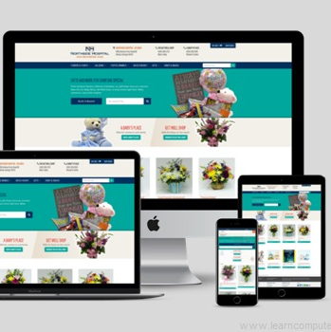



DROP INTO BERLIN
FUTURE PRODUCT ROADMAP
MVP
Implement Description
Improve UX / UI
Complete Database
Create unique identifier for each venue to replace the Place ID of the Google Maps API.
Obtain the data of all restaurants in Berlin.
Adapt the recommendation system to accept a description of a place as input.
Expand Reach
Grow Database
Tagging System
Continue to update the database with venues in other cities and countries.
Include more types of venues like bars, cafés, clubs etc.
Build a tagging system that allows the user to further personalize their search.

Slide 5








MACHINE LEARNING
SCRAPING
WEB APP
DROP INTO BERLIN
Find unique moments
in Berlin
Notes:
● We hope you enjoyed our presentation and we are more than welcome to answer any questions

